Slide 1



Industrial Automation Control Systems Cybersecurity Certification

Slide 2

Index
Who am I?
Background: EU Cybersecurity Act
IACS Certification Landscape
IACS Cybersecurity Certification Framework – ICCF ERNCIP Project
Conclusions & Future

Slide 3

Who am I?

Slide 4
Who am I?
Jose Ruiz – CTO and founder at
LINCE (Lightweight CC) ITSEF (ISO17025) - Based in Spain
EU CyberAct, ICCC and ICMC Program Director.
Editor at IACS ICCF ERNCIP Project
More than 12 years of experience working in CC and FIPS 140-2 as evaluator, lab manager and consultant.

Slide 5

Background: EU Cybersecurity Act

Slide 6


EU Cybersecurity Certification Scheme
A voluntary European cybersecurity certification framework…
              … to enable the creation of tailored EU cybersecurity certification schemes for ICT products and services…
… that are valid across the EU
Source: https://www.eesc.europa.eu/sites/default/files/files/european_commission.pptx

Slide 7
EU Cybersecurity Certification Scheme
ENISA
Consults Industry, Standardisation Bodies, other stakeholders
European Commission
Requests ENISA to prepare Candidate Scheme
ENISA
Prepares candidate scheme
ENISA
Transmits candidate scheme to the European Commission
European Commission
Adopts Candidate Scheme
European Cybersecurity Certification Scheme
European Cybersecurity Certification Group (MSs)
Advises ENISA and may propose the preparation of a scheme to the Commission
Source: https://www.eesc.europa.eu/sites/default/files/files/european_commission.pptx

Slide 8


Core elements
One EU Cybersecurity Certification Framework, many schemes.
Tailored schemes specifying:
  scope - product/service category
  evaluation criteria and security requirements
  assurance level
Resulting Certificates from European
schemes are valid across all Member States.
The use of EU certificates remains voluntary, unless otherwise specified in European Union law.
European schemes “supersedes” National schemes
High
Substantial
Basic
EU Cybersecurity Act Assurance Levels
Source: https://www.eesc.europa.eu/sites/default/files/files/european_commission.pptx

Slide 9

IACS Certification Approaches

Slide 10
State of the art in IACS’ cybersecurity
Different standards & schemes
  ISO 15408 (CC)
    BSI “Smart Meter Gateway” PP
  CC-based Lightweight Method: CSPN, LINCE, etc…
  IEC 62443
Different certification schemes
  CC
  CC-based Lightweight Schemes
  ISAsecure
  UL2900
Different geographic areas
  Mutual recognition issues
  Certificates’ validity across areas
A very specific domain
  Cybersecurity
  Complexity of threats
  Legacy industrial systems
  Constant change in technology
What to certify?
  Systems
  Components
  Processes
How to certify?
  Compliance of product
  Effectiveness of performance
  Safety of processes
  Security

Slide 11
UL 2900
The standard published by UL describes requirements that the Network-Connectable Products developer should be mindful of throughout the life of the product:
  the use of a risk management process for the product based on the identification of threats and vulnerabilities in the product
  the application of security controls in the architecture and design of the product that are based on the assessed risks to the product
The standard also describes methods by which the product is to be assessed (i.e., tested and evaluated) by an independent third-party for the presence of vulnerabilities, malware and security-relevant software weaknesses.
UL 2900 Series:
  UL 2900-1 Ed. 1-2017 - Part 1: General Requirements
  UL 2900-2-1 Ed. 1-2017 - Healthcare And Wellness Systems
  UL 2900-2-2 Ed. 1-2016 - Industrial Control Systems
  UL 2900-2-3 Ed. 1-2017 - Security And Life Safety Signaling Systems

Slide 12
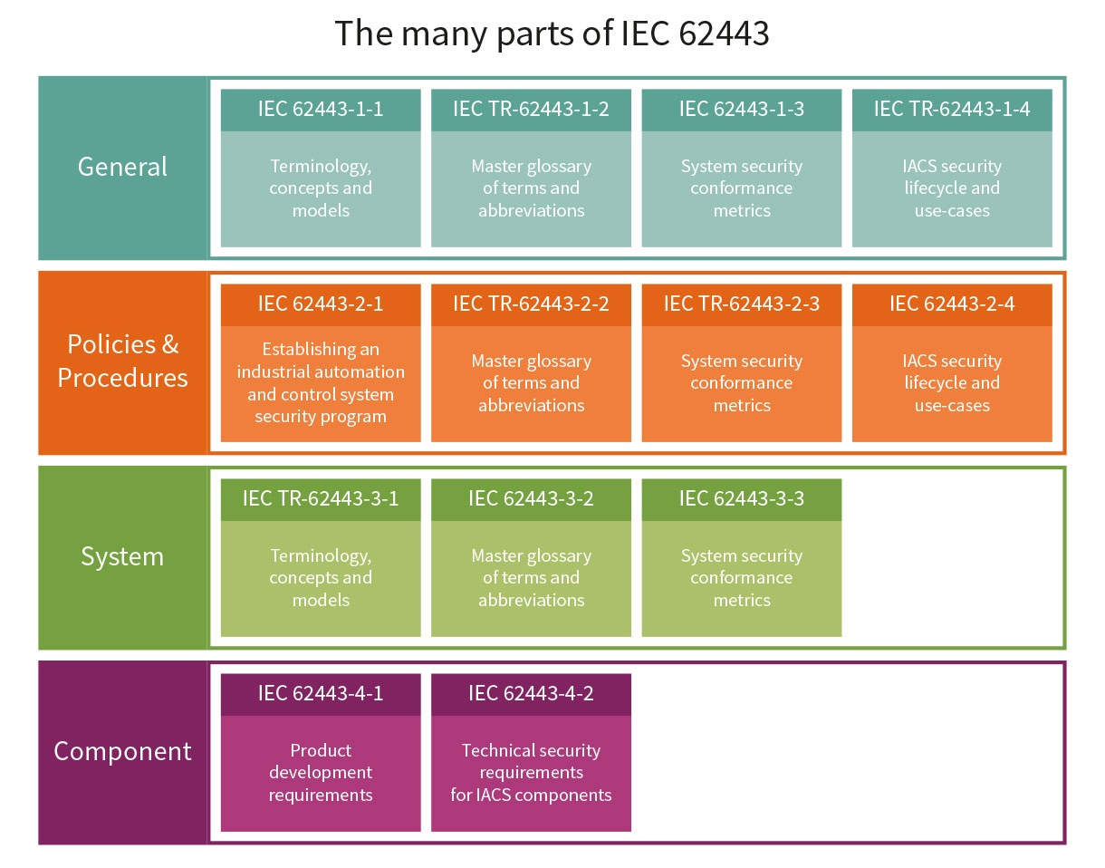
IEC 62443
IEC 62443 Series is a group of standards - flexible framework to address and mitigate current and future security vulnerabilities in (IACSs).
Collection of requirements that an industrial product should meet. It is important to highlight that there is no evaluation methodology issued by IEC.

Slide 13
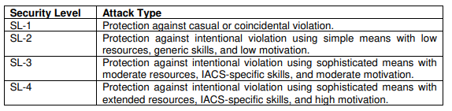
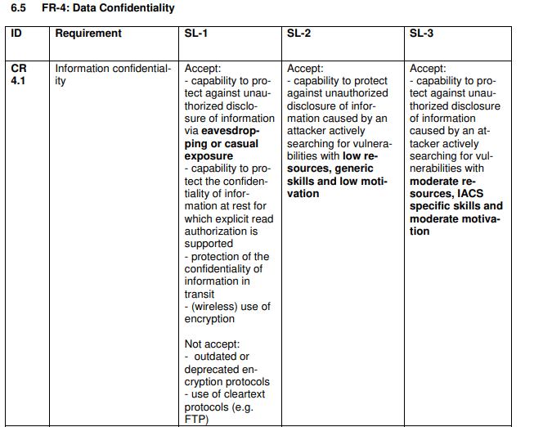
IEC 62443 – TeleTrust Initiative
TeleTrust has developed an evaluation methodology for the requirements stated in IEC 62443-4-2.
https://www.teletrust.de/fileadmin/docs/fachgruppen/TeleTrusT-Evaluation_Method_IEC62443-4-2_2019-05_ENG.pdf

Slide 14

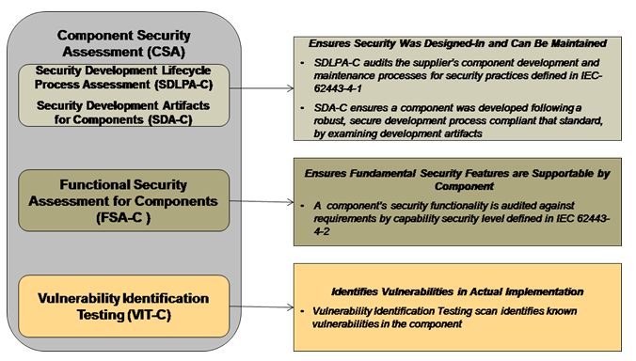
ISA Secure has developed its own certification scheme based on IEC 62443.
  Designed to certify IEC 62443-4-1 and IEC 62443-4-2. The program offers four certification levels for a component
  CSA (Component Security Assurance) Version 1.0. This standard focuses on the security of software applications, embedded devices, host devices, and network devices.

Slide 15

IACS Cybersecurity Certification Framework – ICCF ERNCIP Project

Slide 16
IACS Ecosystem issues
Major priorities
  Safety, reliability, productivity
IACS products’ cybersecurity (CS)
  Legacy systems hard to secure
  Legacy components not secure
  New products can be secured
  Context of integration issues
  Context of use issues
IACS products’ CS certification
  Few certified products so far
  Components’ certification is no guarantee of installations’ cybersecurity.
  Certification is a significant effort.
IACS supply chain
  The makers
  The retailers
  The integrators
  The operators
  The users
  The supporters
  The authorities
Risks
  Staff, methods, controls, goals, strategies.
  Inequal maturity, including security wise.
Cost-driven businesses
  Cost-Benefit balance
  Fear of multiple certifications
The drive of Law
  Obligations & Liabilities

Slide 17
The original intents
Harmonisation across the EU
Mutual recognition across the World
Engagement of stakeholders
ICCF

Slide 18
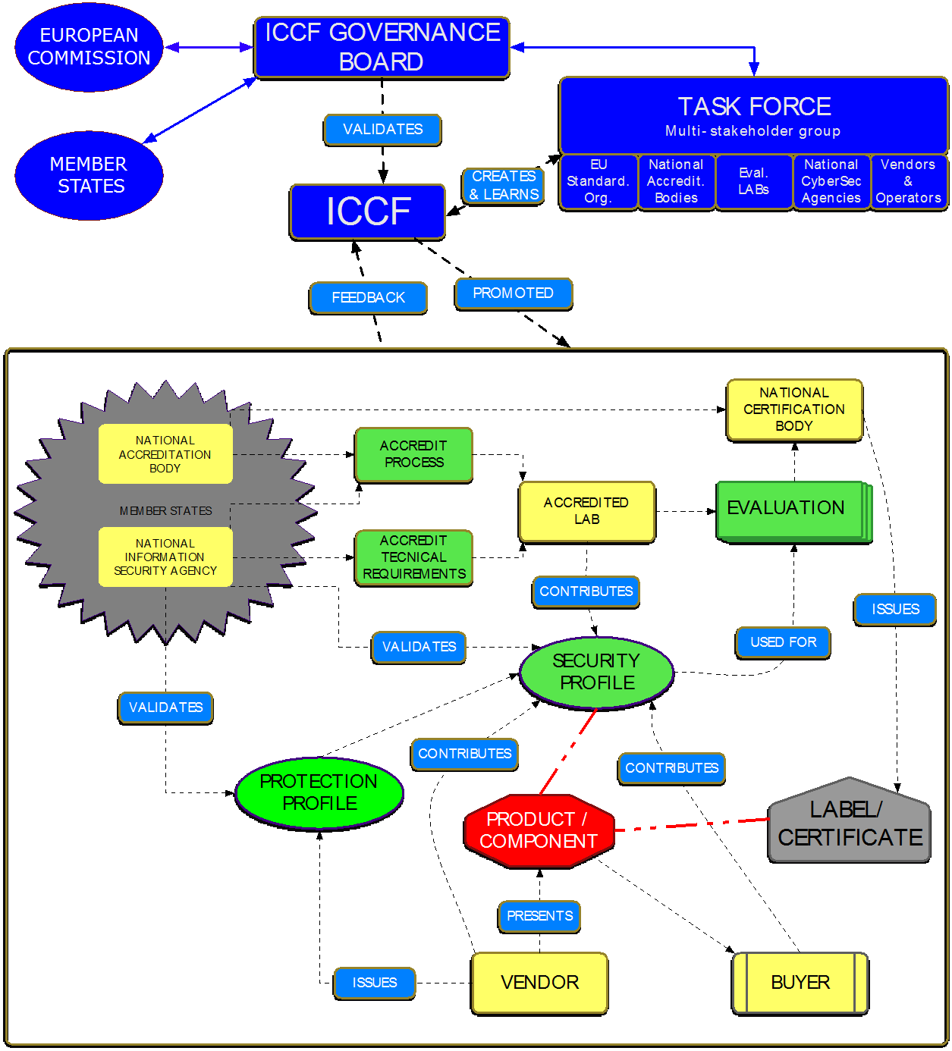
The “original” idea of the ICCF
ICCF report
IACS only
  Old systems but huge potential
The “7A rationale” of the ICCF
  Aimed at IACS cybersecurity
  Adequacy to stakeholders’ situation
  Adoption made easy for all
  Agnosticism vis-à-vis standards
  Affordability for vendors
  Assessability in terms of efficiency
  Applicability in the European context

Slide 19
IACS TG – Phases
Phase 1
2014
Feasibility
Phase 2
2015-2016
ICCF design
Phase 3
2017-2018
ICCF testing & improvement
JOIN(2017)450
COM(2017)477
Phase 4
2019-2020
ECCF/ICCF(s) implementation study
03/2019 to 06/2020
ICCF
NET
NET
NET
CEN-CENELEC

Slide 20

The ICCF (IACS Cybersecurity Certification Framework)
Phase 1-3
Before EU Cyber Act

Slide 21
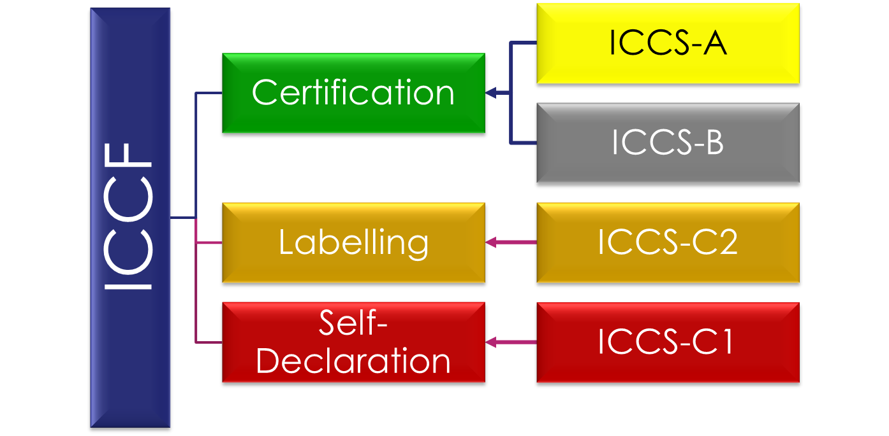
The ICCF and its four levels

Slide 22
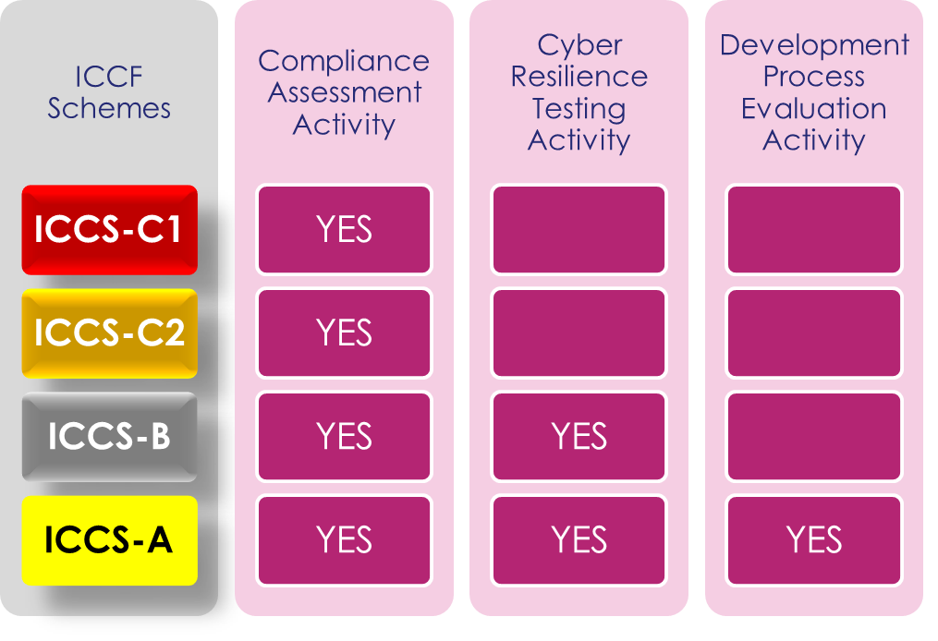
The ICCF’s evaluation activities
ICCS Involve up to 3 Evaluation Activities
  Compliance Assessment (in all four ICCS)
  Cyber Resilience Testing (ICCS-B & A)
  Development Process Evaluation (ICCS-A)

Slide 23
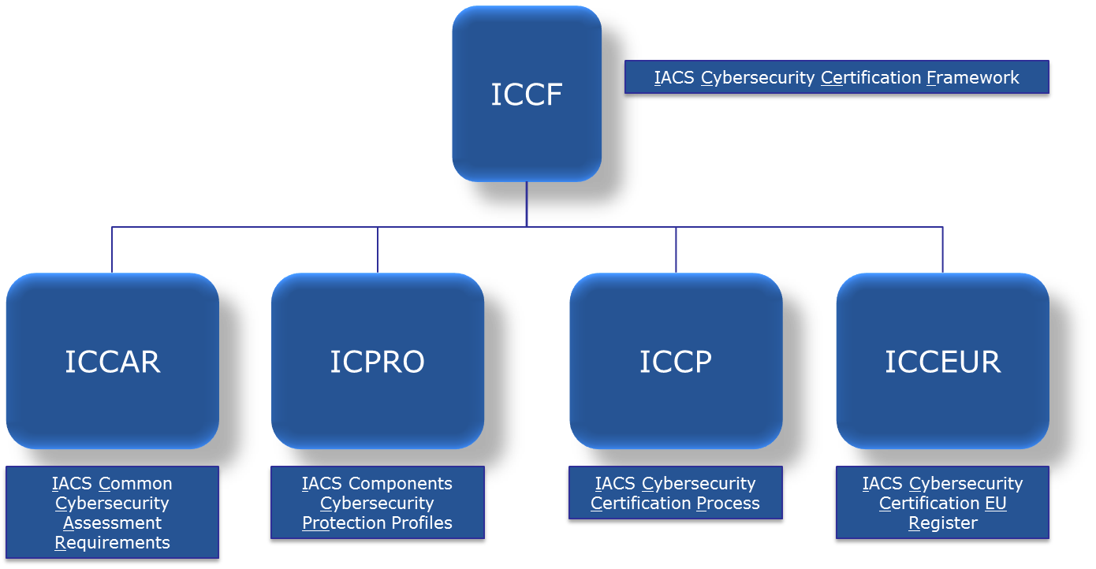
The ICCF’s pillars
Guidelines and resources of 3 Pillars
  IACS Common Cybersecurity Assessment Requirements (ICCAR)
  IACS Components Cybersecurity Protection Profiles (ICCPRO)
  IACS Cybersecurity Certification Process (ICCP)
… And involves a 4th pillar for fostering and disseminating the ICCF
  IACS Cybersecurity Certification EU Register (ICCEUR)

Slide 24
The ICCF’s Common Requirements pillar
Example: List the component security requirements (CR) supplied by (IEC 62443-4-2, Draft 2, Edit 4, July 2, 2015)
Shows
  The association between CRs and security levels (shaded boxes)
  The requirements associated with specific types of components (TCE)

Slide 25
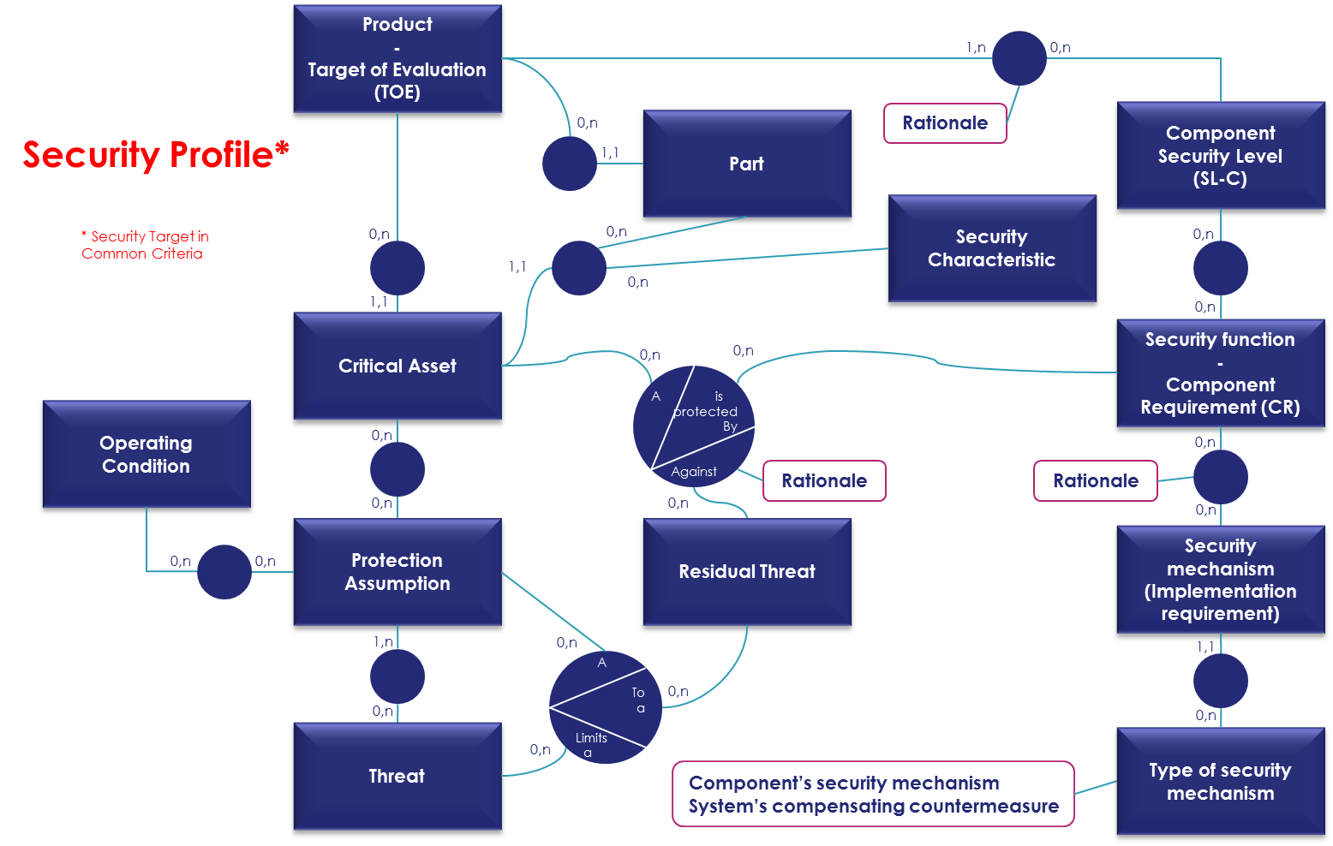
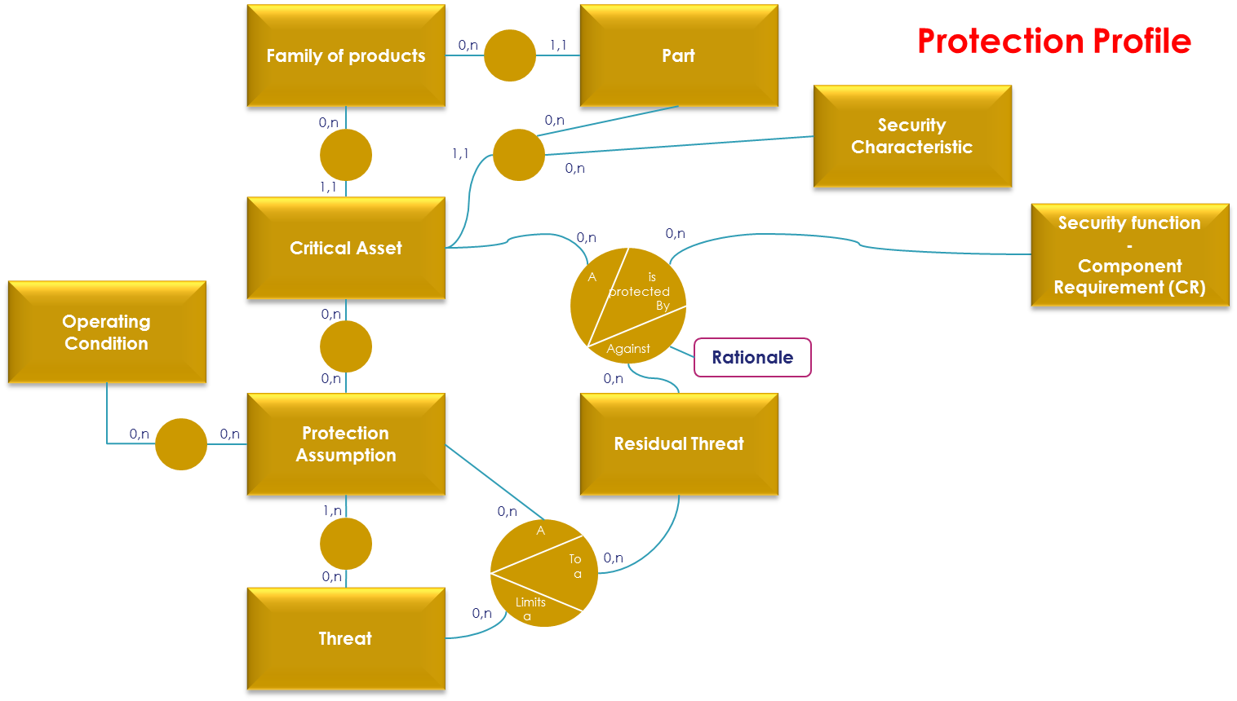
The ICCF’s Protection Profile pillar

Slide 26
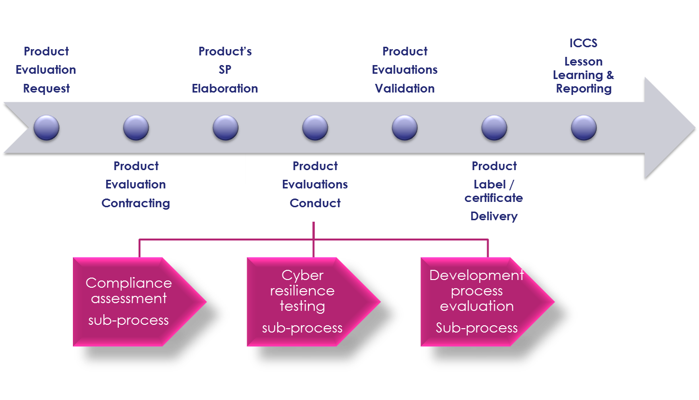
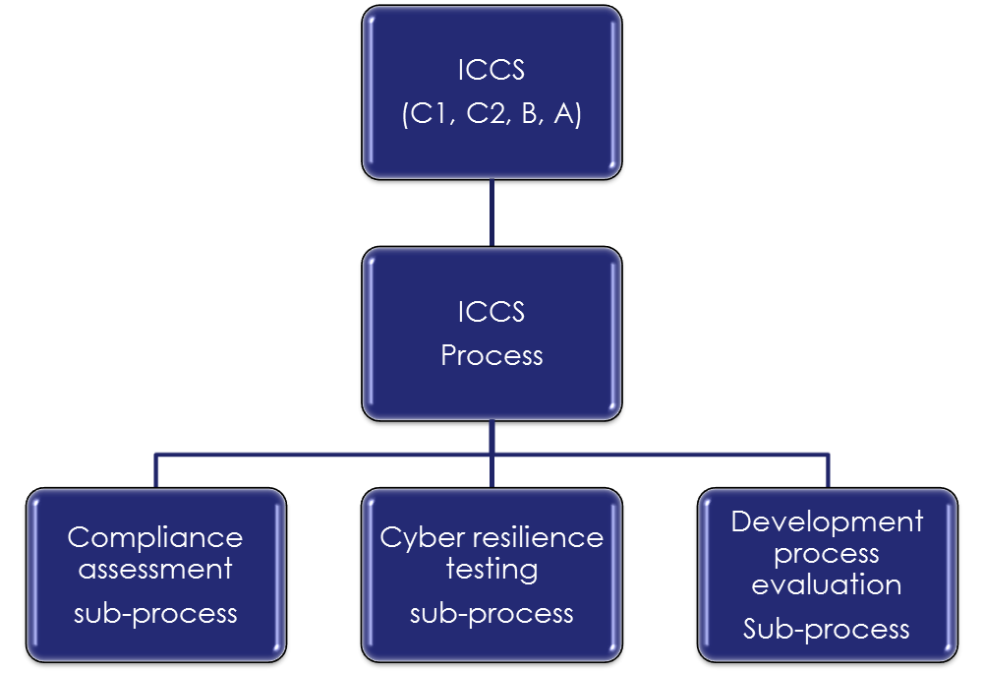
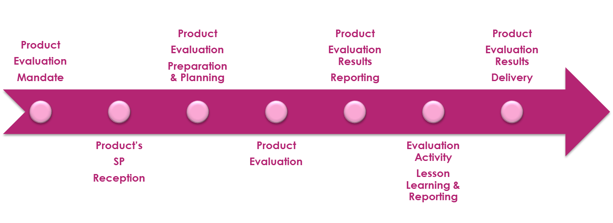
The ICCF’s process pillar

Slide 27
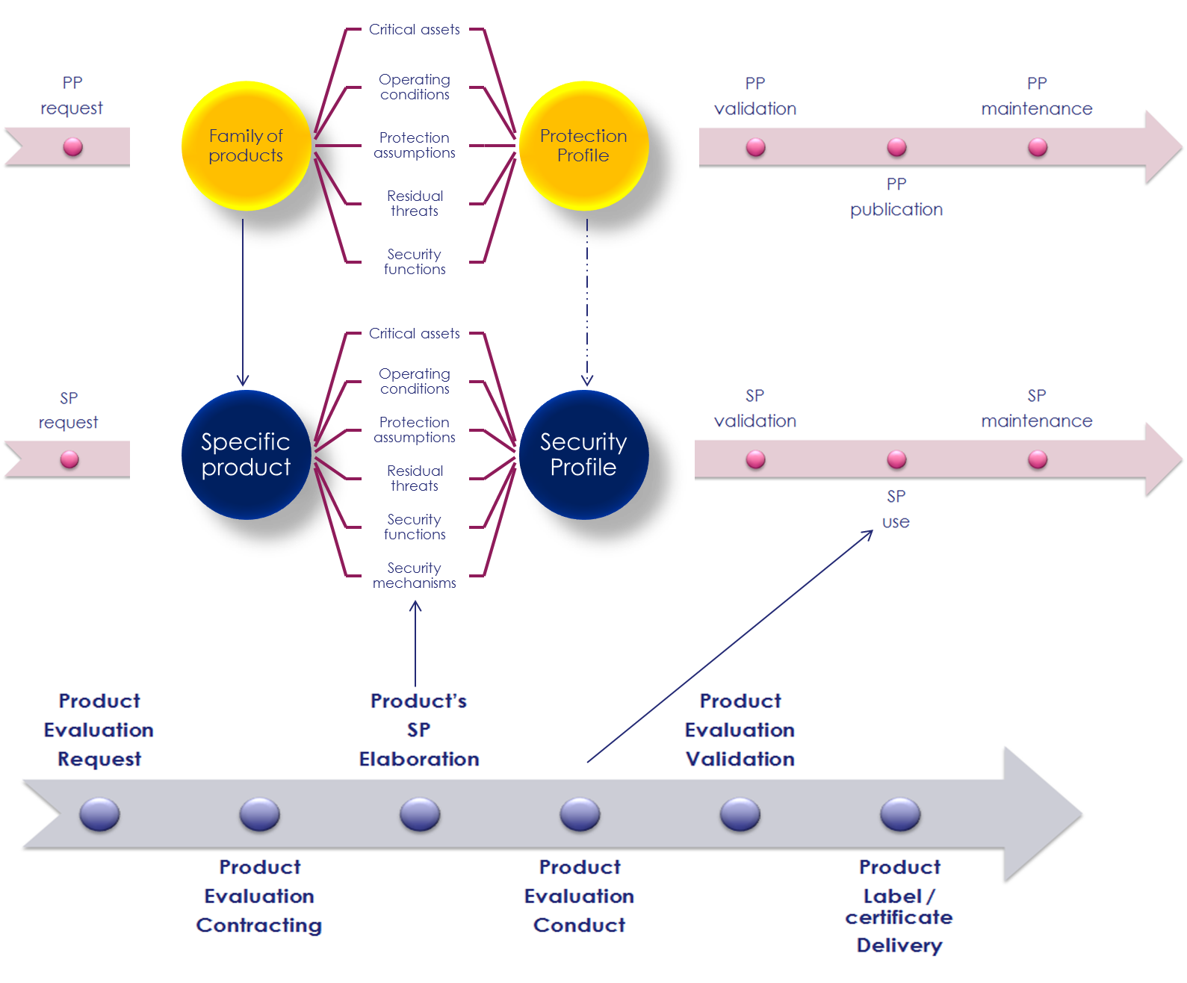
Protection profiles and certification process

Slide 28
ICCF phase 3 tests’ outcome: Elements for future work framing
Goals
  Documenting the state of the art
    NETs’ experience as of today
    Identify gaps in ICCF
Lessons learnt
  Trust in the evaluation process
  Standard process of certification
  Standardization of tests for cross-recognition purpose
  Standard documents required to approve the evaluation and results
  Interaction between labs and vendors during the evaluation
  A common vocabulary
  Certificate maintenance process
  Working under constraints of time and budget
ICCF
NET
NET
NET
NET
NET
CEN-CENELEC
(50% of the WG is not used to certification)

Slide 29
Outcome: the ICCF phase 3
Phase 3 (2017 – 2018)
  Phase 3 report “IACS Cybersecurity Certification Framework (ICCF): Lessons from the 2017 study of the state of the art”
  Standalone document
    Complements ICCF phase 2 report
  Presents the methodology and results of 2017 NETs’ empirical experiments
  Documents the current state of the art of IACS Cybersecurity Certification
  Identify gaps to fill
  Concludes on the way to make the ICCF the first usable scheme in the context of the ECCF.

Slide 30

The ICCF (IACS Cybersecurity Certification Framework)
Phase 4
After EU Cyber Act

Slide 31
ICCF phase 4’s outcome: Setting goals for every stakeholder
JRC
Experimental CSC* Lab
CEN JTC13
Standard Initiative
ENISA& CNECT
Recommendations for candidate Scheme
GROW
Industry
Exportable and Influential ICCF Certification
Proactive Industry’s engagement
Goals
Projects
Outcome
* CSC = CyberSecurity Certification

Slide 32
The ECCF and its implications for the ICCF
JOIN(2017)450
COM(2017)477
2019 Legislation to come
European Cybersecurity Certification Framework (ECCF)
  3 levels
    Basic
    Substantial
    High
Central role of ENISA as coordinator
Certification scheme
Industry
DG CNECT
ENISA
Stakeholders
+ SOGIS
+ CSPN
+ ISA Secure
+ …
+ NIS DIRECTIVE 2016 EU 1148
+ Sectorial regulations
+ …
+ ISO 17065 (for certification bodies)
+ ISO 17011 (for accreditation bodies)
+ ISO 17025 (for labs)

Slide 33
What comes next: the ICCF phase 4
Phase 4 (2019 - 2020)
  Main goals
    Supporting the implementation of the ECCF
      Elaborate the ECCS (Scheme) for IACS products (the “ICCS”) with stakeholders
      Document findings & recommendations for the benefit of DG CNECT & ENISA
  Further activities will be carried out
    To support the methodology standardisation NWI – JTC13 WG3
    To prepare JRC’s experimental lab
    Prepare a report with recommendations for DG CNECT and ENISA
    To work towards industry’s engagement
  Old and new NETs & partners

Slide 34
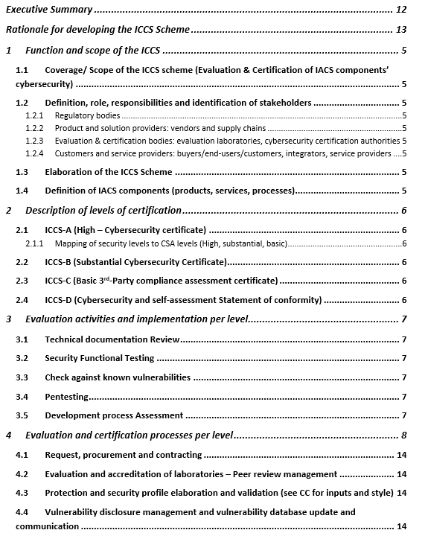
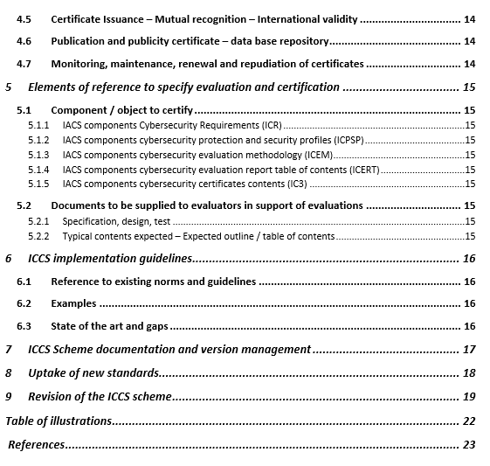
Phase 4 Report Outline

Slide 35
The phase 4 broad plan and its 7 tasks
Framing Phase 4
Preparatory plan of action
European ICCS elaboration
ICCS elaboration
European Processes & KPIs
Workflow, processes & KPIs for DG CNECT & other stakeholders
Standardisation
CEN – JTC13
Kick-off meeting & Engagement
Stakeholders
Mutual recognition
Steering group
Evaluation Standard
International compatibility with European Cybersecurity certification schemes
Report & dissemination
Dissemination
Final report
KOM: 25/03/19
Big Picture: 07/19
Critical review
Conclusions
Intermediary report
Intermediary report
T0
T2
T4
T6
T1
T3
T5
02/2019
03/2019-06/2020
07/2019-05/2020
05-06/2020
01-05/2020
01-05/2020
07/2019-05/2020

Slide 36

Conclusions & Future

Slide 37

Conclusions
EUCyberAct – change completely the Cybersecurity Certification Landscape
  Only in Europe?
IACS certification needs to avoid fragmentation
  Several schemes – Confusion
ICCF Thematic Group
  Good work so far!
  Still a lot to do!
    More support is welcome!

Slide 38
Thank you!
jtsec Beyond IT Security
Granada & Madrid – Spain
hello@jtsec.es
@jtsecES
www.jtsec.es
“Any fool can make something complicated. It takes a genius to make it simple.” - Woody Guthrie

